Slide 1

An introduction to Raspberry Pi & Python Programming
Mr Martin Thong
Mr Wong Kim Siong
Robotics Connection Pte Ltd
Updated on August 2016

Slide 2
Course objectives:
Be familiar with the Raspberry Pi Hardware
Learn basic python commands
Understand circuit diagrams and assemble them
Use python to control RPi GPIOs
Use RPi to control a robot car, GoPiGo

Slide 3
6-lesson Agenda
Lesson 1
Introduction to Raspberry Pi hardware
Setting up the Raspberry Pi
Introduction to Python Programming
Print statements, do calculations, create variables, understanding different data types
Introduction to GPIO Pins
Programming LEDs to ON/OFF
Lesson 2
Introduction to Python Programming
Getting user input, decision making, using loops
Programming LEDs to blink

Slide 4
6-lesson Agenda
Lesson 3
Programming buttons as an input to ON/OFF LEDs
Programming buttons to control LED brightness
Lesson 4
Programming the Raspberry Pi to control a robot car
Use of touch sensor, ultrasonic sensor, colour-sensor
Remote-control

Slide 5
6-lesson Agenda
Lesson 5
Lesson 6

Slide 6
Raspberry Pi
Is a credit sized computer that runs on linux
Specifications of RPi 3
A 1.2GHz 64-bit quad-core ARMv8 CPU
802.11n Wireless LAN
Bluetooth 4.1
Bluetooth Low Energy (BLE)
1 GB RAM
4USB ports
40 GPIO pins
Full HDMI port
Ethernet port
Combined 3.5mm audio jack and composite video
Camera interface (CSI)
Display interface (DSI)
Micro SD card slot
VideoCore IV 3D graphics core

Slide 7
Different versions of Raspberry Pi

Slide 8
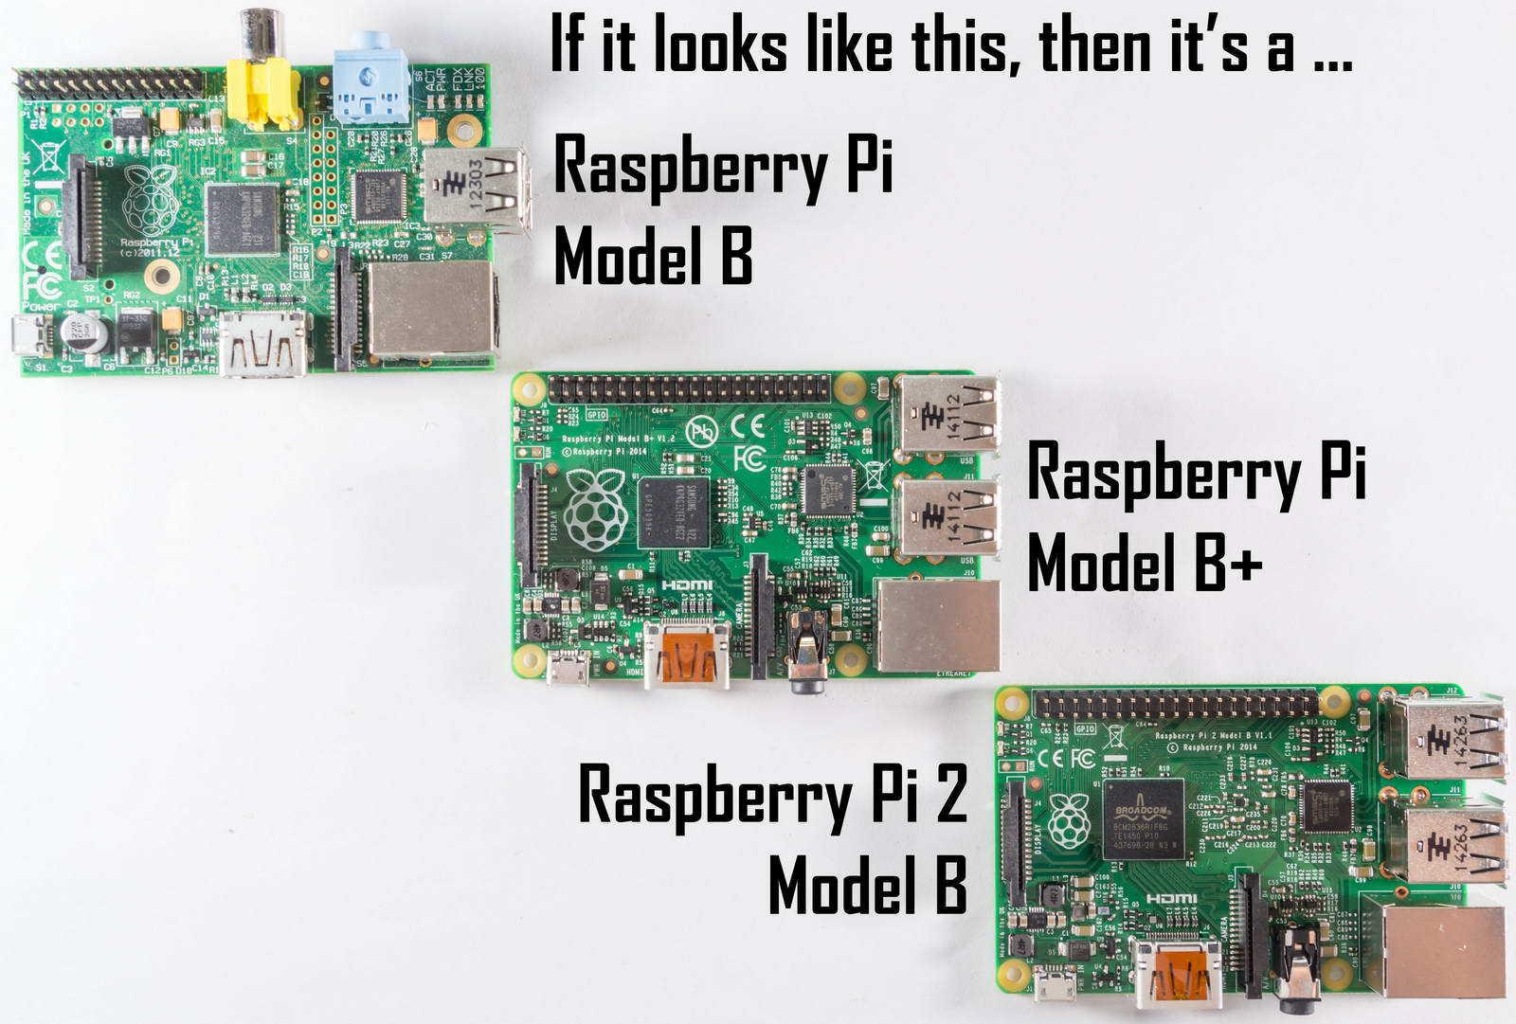
Different versions of Raspberry Pi

Slide 9
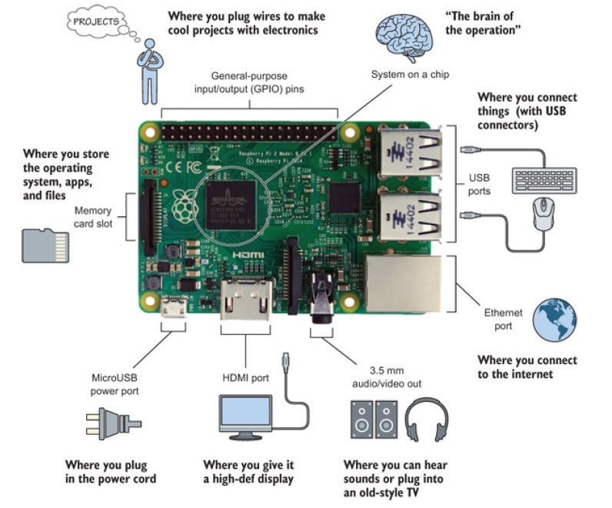
The Top View of RPi

Slide 10
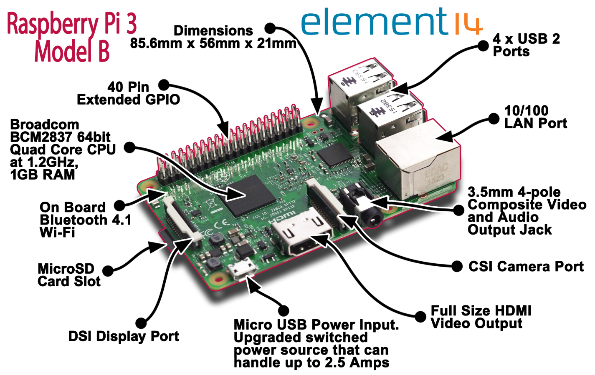
Raspberry Pi 3 Model B

Slide 11
What can I do with RPi?
Use as a secondary / back-up PC
Do word-processing & spreadsheets
Running a multi-media center
Learn Programming (eg. Python)
Use as a micro-controller (eg. To control a robot)
Create your own projects

Slide 12
Setting up the SD card
Go to the link below to download the SD Card formatter 4.0 software.
https://www.sdcard.org/downloads/formatter_4/
Use it to format an SD card which is 4GB or larger as FAT
Go to the link below to download the latest NOOBS zip file
https://www.raspberrypi.org/downloads/
(Optional) Go to the link below to download the hashcheck software and install it.
http://code.kliu.org/hashcheck/
You can use it to check whether the file you have download is corrupted.
Right-click on the file you have downloaded and look under checksums.
Extract the files from the NOOBS zip file and copy onto the SD card.

Slide 13
Back-up your SD card
Go to the link below to download the WIN32Imager software.
https://sourceforge.net/projects/win32diskimager/
Use this software to backup your SD card as often as needed.

Slide 14
Setting up the hardware
Put your RPi in a case to protect it from accidental damage
Insert your SD card into the memory card slot
Connect your keyboard and mouse using the USB ports
Connect your monitor using the HDMI port
Plug in your power cord using the power port

Slide 15
Boot-up your RPi
On first boot, select Raspbian
Default userid: pi
Default password: raspberry
To start Graphical User Interface, type startx
To always start in the Graphic User Interface (GUI)
type sudo raspi-config
Go to Boot Options
Select Desktop Autologin

Slide 16
Personalise your RPi
Click on Menu, Preferences, Raspberry Pi Configuration
Under System
Change your password
Change your hostname
Under Localisation
Set Locale, Timezone, Keyboard and Wifi country

Slide 17
Add/delete new user
Launch Terminal (Command Line Shell)
To add a user, type sudo adduser martin
You will be prompted for a password for user martin. Leave blank for no password.
To disable a user, type sudo deluser martin
To delete all traces of user, type
sudo deluser –remove-all martin

Slide 18
Why Python?
Simple yet elegant (very clear and readable syntax)
Excellent for beginners, yet superb for experts
Cross Platforms (Windows, Mac, Linux etc.)
Open source (Free)
Skills learned will be portable to different programming languages (e.g. Java, C++, etc)
Preferred programming language by Raspberry Pi

Slide 19

Getting Started with Python
We will be using Geany to learn python v3:
Print messages
Using python to do calculations
Create variables
Getting user input
If … else … statements
while loop and for loop

Slide 20
Start Geany
Look for the icon on the Desktop and click on it to open.
Click “New” and then “save as”
Create a new folder on Desktop using your name. You will be saving all your python files inside.
Name of file : “examples.py”
Press save to save your file.

Slide 21
Print messages
Type print (“Hello World”)
Press the execute button or F5 to run your program
Congratulations!!! You have created your first python program.

Slide 22
Try this!
print (“My name is <your name>”)
print (“ I am <your height> m tall.”)
print (“I weigh <your weight> kg.”)
print (“I work at <your workplace>”)
Press the execute button or F5 to run your program
Try and type your own messages
Notes:
Run a few negative examples: Print , without quotes, different quotes.

Slide 23

Do calculations
print (3 + 5)
print (18 – 2)
print (12 * 18)
print (3 ** 2)
print (10 / 3)
print (10//3)
print (10 % 3)
What about more complex calculations?
Notes:
** - to the power of, / - divide by, returns decimal, // - floor division, returns the integer, % - modulus, returns the remainder

Slide 24
Precedence of Operators
Operator | Description
() | Brackets
** | Exponentiation
* / % | Multiply, divide, modulus
+ – | Addition and subtraction
Do first
Do last
Hence, 10 – 3 * 2 and (10 – 3) * 2 will give different answers. Try it!
10 – 3 * 2 = _____
(10 – 3) * 2 = _____

Slide 25
Create Variables
A variable is like a box. It can keep things inside.
Examples:
msg = “Good morning!”
ans = 3+5
print the variable to see what is stored inside
print (msg)
print (ans)
msg
ans
“Good morning!”
8

Slide 26
Data Types
Each variable can only store 1 data type.
The 4 main data types are:
Integer – represents whole numbers
Float – represents numbers with decimal points
String – represents sets of characters in between single or double quotes
Boolean – represents one of two values: True, False

Slide 27
Can you identify the data type?
Integer
Float
String
Boolean
 | Value | Data Type
1. | True
2. | “Programming”
3. | “True”
4. | 101
5. | False
6. | 123.456
7. | “123.456”
8. | “^_^”
9. | “SOS - 999”
10. | “Testing 1 2 3…”

Slide 28
Variable names
Variable names can be made up of letters, numbers and the underscore character (_)
They cannot start with a number.
Variable names should be meaningful. It should represent what you want to store inside.
Eg. age = 14, my_height = 1.5,
scienceGrade = “A”

Slide 29
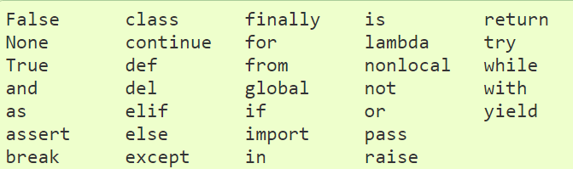
Reserved Python Keywords
These words cannot be used as variables

Slide 30
Printing string and integers together
Given:
msg = “The time now is ”
time = 1415
print (msg + str(time))
Given:
day = 18, month = “August”, year = 2016
Can you use the given variables to print today’s date as 18th August 2016?

Slide 31
Programming Challenge 1
Create a variable x and assign it a value of 23
Create a variable y and assign it a value of 2.5
Create a variable z and assign it a value of “robots are fun!”
Create a variable flag and assign it a value of False
Create a variable is_weekday and assign it a value of True

Slide 32
Programming Challenge 2
1. Given:
age = 5
print (“age”)
What gets printed?
2. Given:
a = “hazy”
b = “day”
How to print “hazy day” using variable a and b?

Slide 33
Programming Challenge 3
Given:
x = 5
y = 10
How to print the result of multiplication of x and y?
Given:
age1 = 5
age2 = “6”
Using the variables given, how to print 56 and 30?

Slide 34
Programming Challenge 4
Create 4 variables and put your name, workplace, height, weight in it.
Display the following using the variables you have created:
My name is <variable_name>.
I work at <variable_workplace>.
I am <variable_height> m tall.
I weigh <variable_weight> kg.
My BMI is <variable_bmi>.
Notes:
Create another variable bmi.

Slide 35
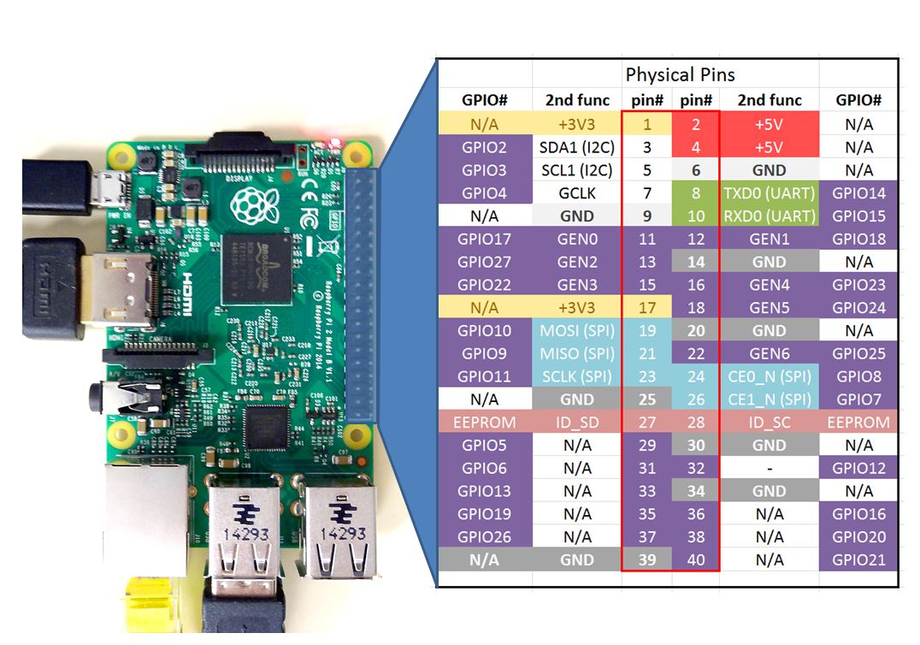
RPi GPIO Pins labels

Slide 36
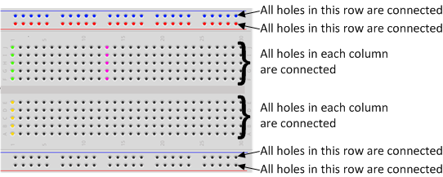
The Breadboard
The breadboard is a way of connecting electronic components to each other without having to solder them together.
The holes on a breadboard are connected in a pattern as shown below.

Slide 37
The LED
LED stands for Light Emitting Diode
It glows when electricity is passed through it
Long leg (anode) always connect to the positive power supply. (V+)
Short leg (cathode) always connect to the negative power supply. (ground)
*LED will not light up if connected the wrong way!

Slide 38
The Resistor
The purpose of the resistor is to limit the current going through the LED.
Passing too high a current through the LED will damage it.

Slide 39
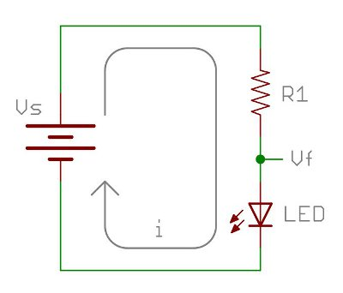
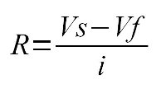
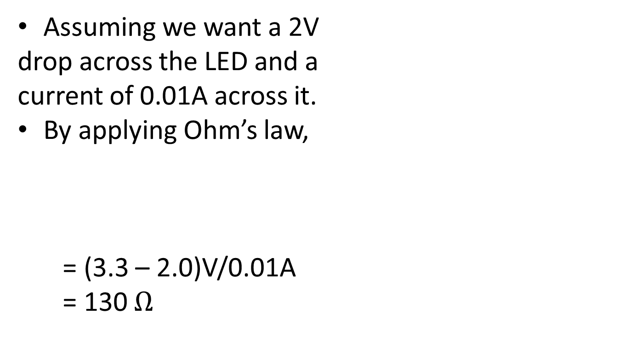
How to calculate resistance?
Assuming we want a 2V
drop across the LED and a
current of 0.01A across it.
By applying Ohm’s law,
= (3.3 – 2.0)V/0.01A
= 130 $Ω$

Slide 40
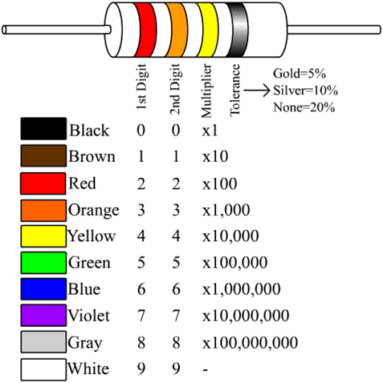
How to read resistor values?

Slide 41
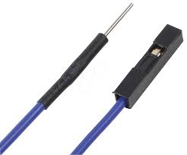
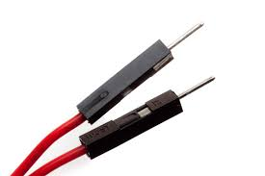
Jumper wires
Jumper wires are used on breadboard to “jump” from one connection to another.
We always use red wires to connect to V+ and black wires to connect to ground.
male-female male-male

Slide 42
Programming an LED ON/OFF
Things we need:
RPi GPIO pins
A breadboard
An LED
A 330 ohm resistor or higher
2 male-female jumper wires
3 male-male jumper wires

Slide 43
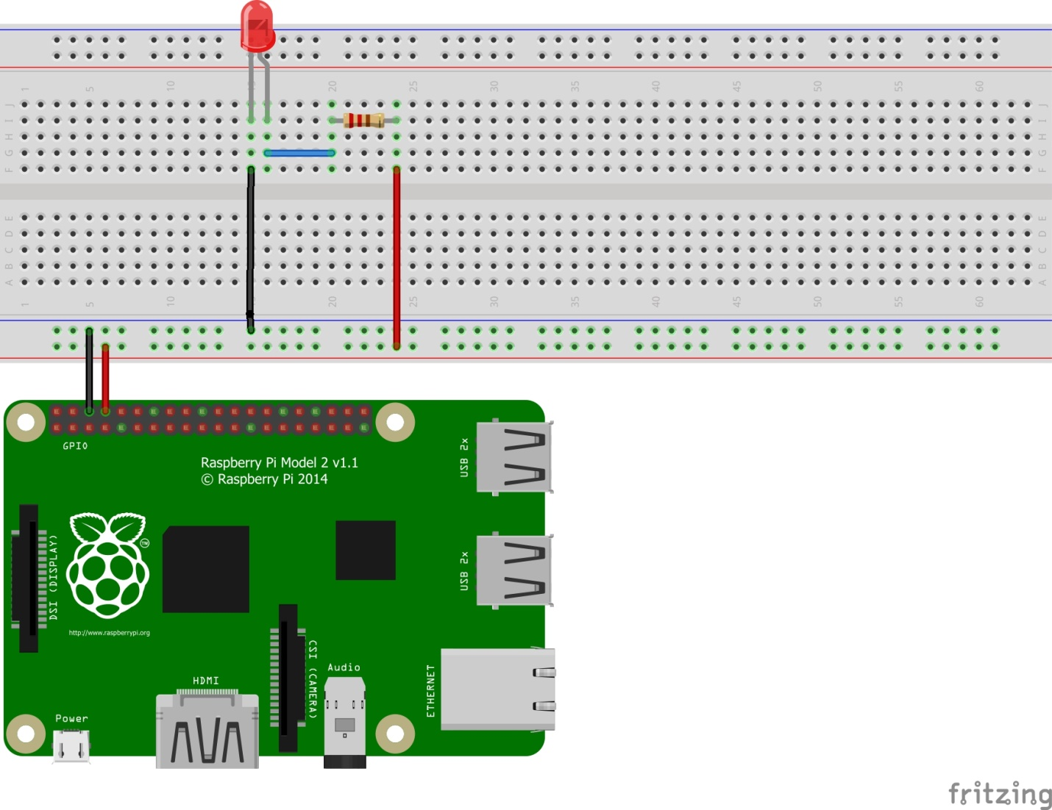
Time to connect our circuit ☺
It is a good practice to turn off your RPi when connecting your GPIO to prevent short-circuit.
Physical pin 6 – ground
Physical pin 8 - output

Slide 44
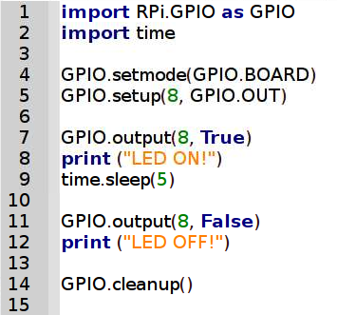
Time to program our LED
Turn on your RPi and launch Geany.
Create a new *.py file and rename it as led.py
Type the following codes:
Did you see the LED turn ON and then OFF?
Did you see the screen print out the words?

Slide 45
RPi Challenge 1
Fix up a similar circuit and connect this LED to pin 10.
Can you ON/OFF this LED using pin 10?
Can you ON/OFF both LED at the same time?
Can you ON/OFF the 1st LED for 3 seconds and then the 2nd LED for 6 seconds?

Slide 46
RPi Challenge 2
Fix up another similar circuit.
Which other GPIO pin can we use?
Can you ON/OFF the 3 LEDs in this sequence, A ->B ->C ->B ->A? LEDs will be on for 2 seconds each.

Slide 47
Lesson 2

Slide 48
Getting User Input
Use input() to ask for user input
Eg. name = input(“What is your name?” )
age = input(“What is your age? ”)
Can you print the person’s name and age on the screen?
Sample output:
Your name is Martin. You are 25 years old.

Slide 49
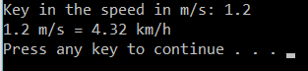
Programming Challenge 5
Can you convert speed in m/s to km/h?
Ask the user to key in the speed in m/s and display the speed in km/h.
Sample output:

Slide 50
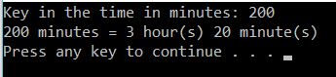
Programming Challenge 6
Can you write a program that converts time in minutes to time in hours and minutes?
Ask the user to key in the time in hours and display the time in hours and minutes.
Sample output:

Slide 51
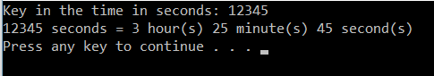
Programming Challenge 7
Can you convert time in seconds to time in hours, minutes and seconds?
Ask the user to key in the time in seconds and display the time in hours, minutes and seconds.
Sample output:

Slide 52
Decision Making 1
If a program does the same thing forever, it is boring and not very useful.
Programs must be able to make decisions what to do based on user’s input(s).
Example:
If the user key in the correct answer, add 2 point to the score. If the user key in the wrong answer, minus 1 point to the score.

Slide 53
Decision Making 2
A program will make decision by testing a condition, whether it is True or False.
If it is True, it will execute the codes in the True branch.
If it is False, it will execute the codes in the False branch.

Slide 54
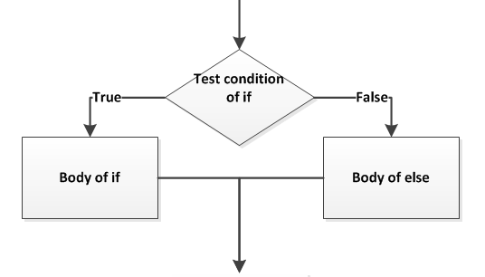
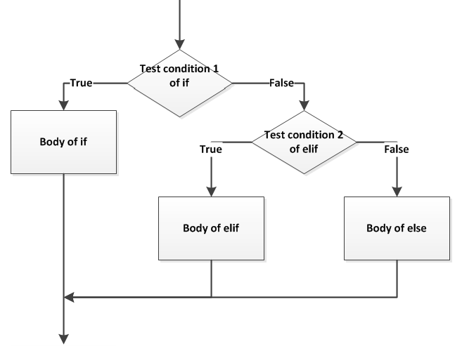
Decision Making 3
if <condition is True>:
<execute the codes in the True branch>
else: #(<condition is False>)
<execute the codes in the False branch>
if <condition 1 is True>:
<execute the codes in the body of If>
elif <condition 2 is True>:
<execute the codes in the body of elif>
else: #(<both condition 1 and 2 are False>)
<execute the codes in the body of else>

Slide 55
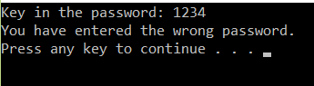
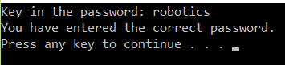
Password checker 1
Let’s setup a password checker to give the following sample outputs:

Slide 56
Password checker 2
Step 1: Setup a password.
Step 2: Ask user to enter password.
Step 3: Test the password.
Step 4: print appropriate statements depending on condition.
Sample code:
correct_password = ____________________ #(step 1)
password = ____________________________ #(step 2)
if password == correct_password: #(step 3)
print _______________________________ #(step 4)
else:
print _______________________________ #(step 4)

Slide 57
Conditions in Decision Making
The condition(s) in a test can be expressed through the use of comparison operators.
Expression | What it does
a == b | Evaluates to True when a is equal to b
a != b | Evaluates to True when a is not equal to b
a < b | Evaluates to True when a is less than b
a > b | Evaluates to True when a is more than b
a <= b | Evaluates to True when a is less than or equal to b
a >= b | Evaluates to True when a is more than or equal to b

Slide 58
When to use =, ==?
a = 1 assigns the value 1 to the variable a
a == 1 checks whether the variable a is equal to 1.
It returns True if they are equal
It returns False if they are not equal

Slide 59
Programming Challenge 8
Can you write a program that tells the shopper what is their free gift based on this table?
Tip: Use if…elif…else…
Amount spent | <$100 | >= $100 | >= $500
Free Gift | None | Cap | Shaver

Slide 60
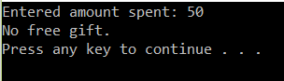
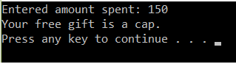
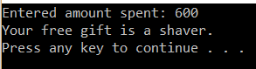
Sample outputs:
This program can only run for one shopper. But there are hundreds of shoppers a day. How can we improve our program?

Slide 61
Repetition
We can write a program that do the same thing over and over again until a condition is satisfied.
We can use a while-loop or a for-loop to achieve this.

Slide 62
A forever while-loop
Example:
status = True
while status == True:
<do these>
Let’s implement the while-loop in our free gift codes.
Set initial condition
Check condition
Ends with a colon
Codes are indented

Slide 63
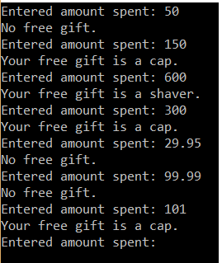
Sample output:

Slide 64
While-loop with exit 1
Example 1:
num = 0
while num < 10:
print (num)
num = num + 1
The above codes will print ___________
Once num = 10, it will exit the while loop.
Can you use a while loop to print 10-1?

Slide 65
While-loop with exit 2
Example 2:
num = 0
while num < 10:
if num == 5:
break
print (num)
num = num + 1
The above codes will print ___________
Once num = 5, it will exit the while loop.
Can you modify your password checker such that the user will keep trying until he gets his password correct?

Slide 66
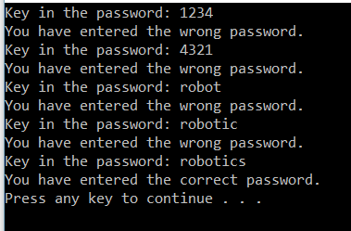
Sample output:

Slide 67
For-loop 1
Example:
for i in range(3):
print (i)
What numbers get printed? ___________
range(x) function is often used with for-loop when we know how many times we want to run the loop repeatedly.
The value of the variable “i” takes on the value 0 → 1→ 2…. each time the loop is repeated.

Slide 68
For-loop 2
What if we want to print numbers from 10…49?
for i in range(10, 50, 1):
print i
What if we want to print 10, 20, ….90, 100?
What if we want to print 100, 95, … 15, 10?
Start
i = 10
End
i = 50-1
Step
+1

Slide 69
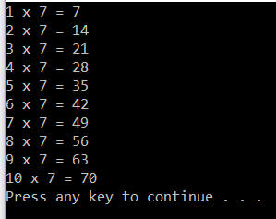
Programming Challenge 9a
Can you print out the 7 times table using 2 lines of code?
Sample output:

Slide 70
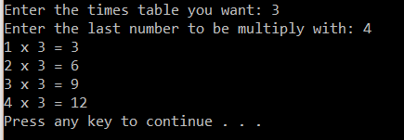
Programming Challenge 9b
Can you let the user decide what times table he wants?
Can you let the user decide what the last number to be multiply with?
Sample output:

Slide 71
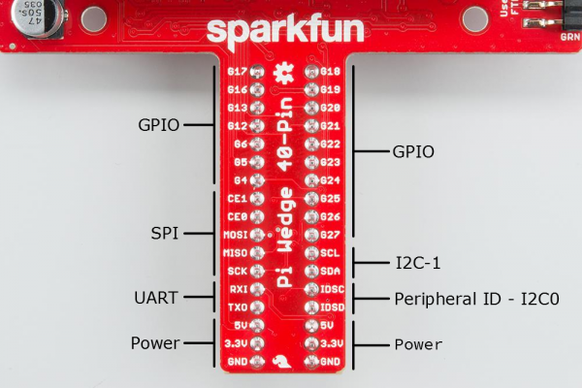
Pi Wedge Pin mapping

Slide 72
Blinking LED 1
We are going to do it by using a Pi Wedge.
Why use a Pi Wedge?
It gives a clearer indication of the pins used
Shut down your RPi
Power up again after you have connected the ribbon to the GPIO.

Slide 73
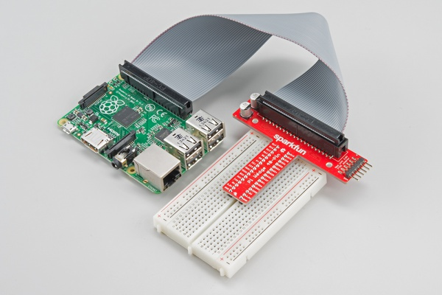
Blinking LED 2
Let’s fixed up the RPi, Pi Wedge, breadboard and the 40-pin ribbon cable as shown.
Red edge of ribbon connected to GPIO pin 1 and 2

Slide 74
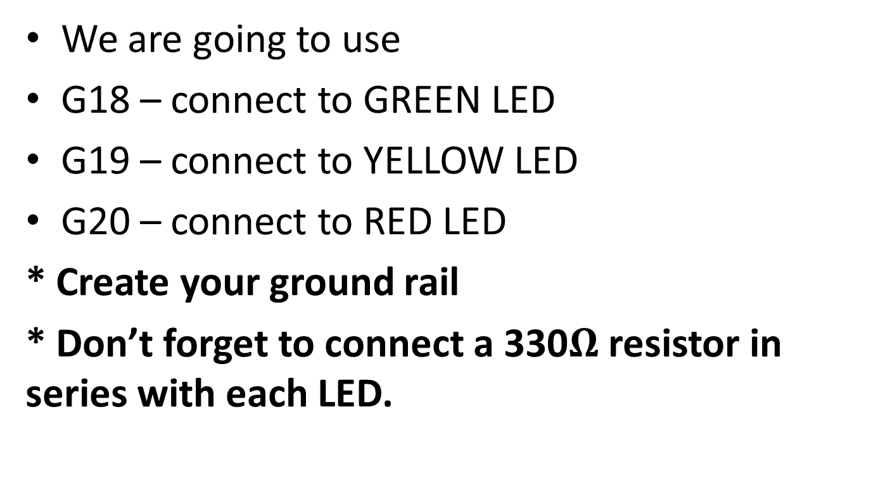
Setting up the circuitry
We are going to use
G18 – connect to GREEN LED
G19 – connect to YELLOW LED
G20 – connect to RED LED
* Create your ground rail
* Don’t forget to connect a 330$Ω$ resistor in series with each LED.

Slide 75
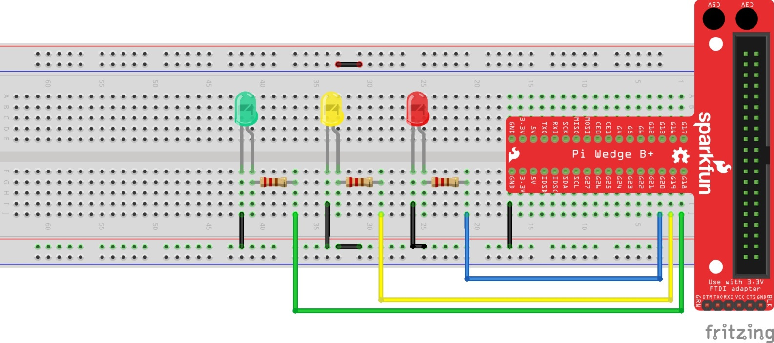
Sample circuit diagram

Slide 76
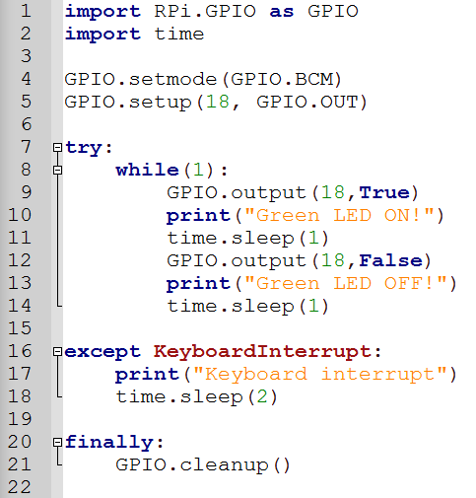
Programming a blinking LED

Slide 77
RPi Challenge 3
Can you program the LED to blink in sequence? Green, Yellow, Red, Green, Yellow Red, … (forever)

Slide 78
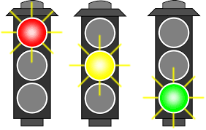
RPi Challenge 4
Can you use 6 LEDs to simulate a traffic light junction in real life? Green will be on for 20 secs, yellow for 2 secs, then red for (?) secs.

Slide 79
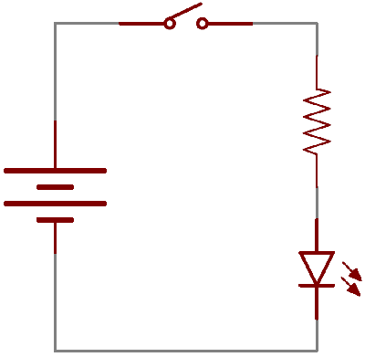
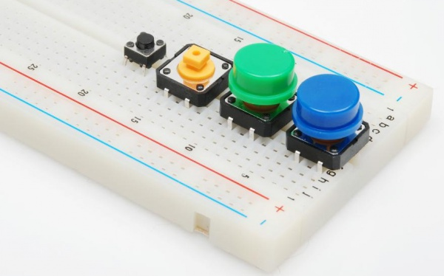
Button
A button is a momentary switch that remains ON when pressed. If it is not pressed, it will be OFF.

Slide 80
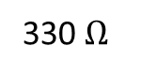
Let’s build this circuit
We are going to use the BOARD mode and use the button to ON/OFF the LED.
The LED will remain ON as long as the button is pressed. No programming needed.
Button with green cap
330 $Ω$
3.3 V
physical pin 1
Green LED

Slide 81
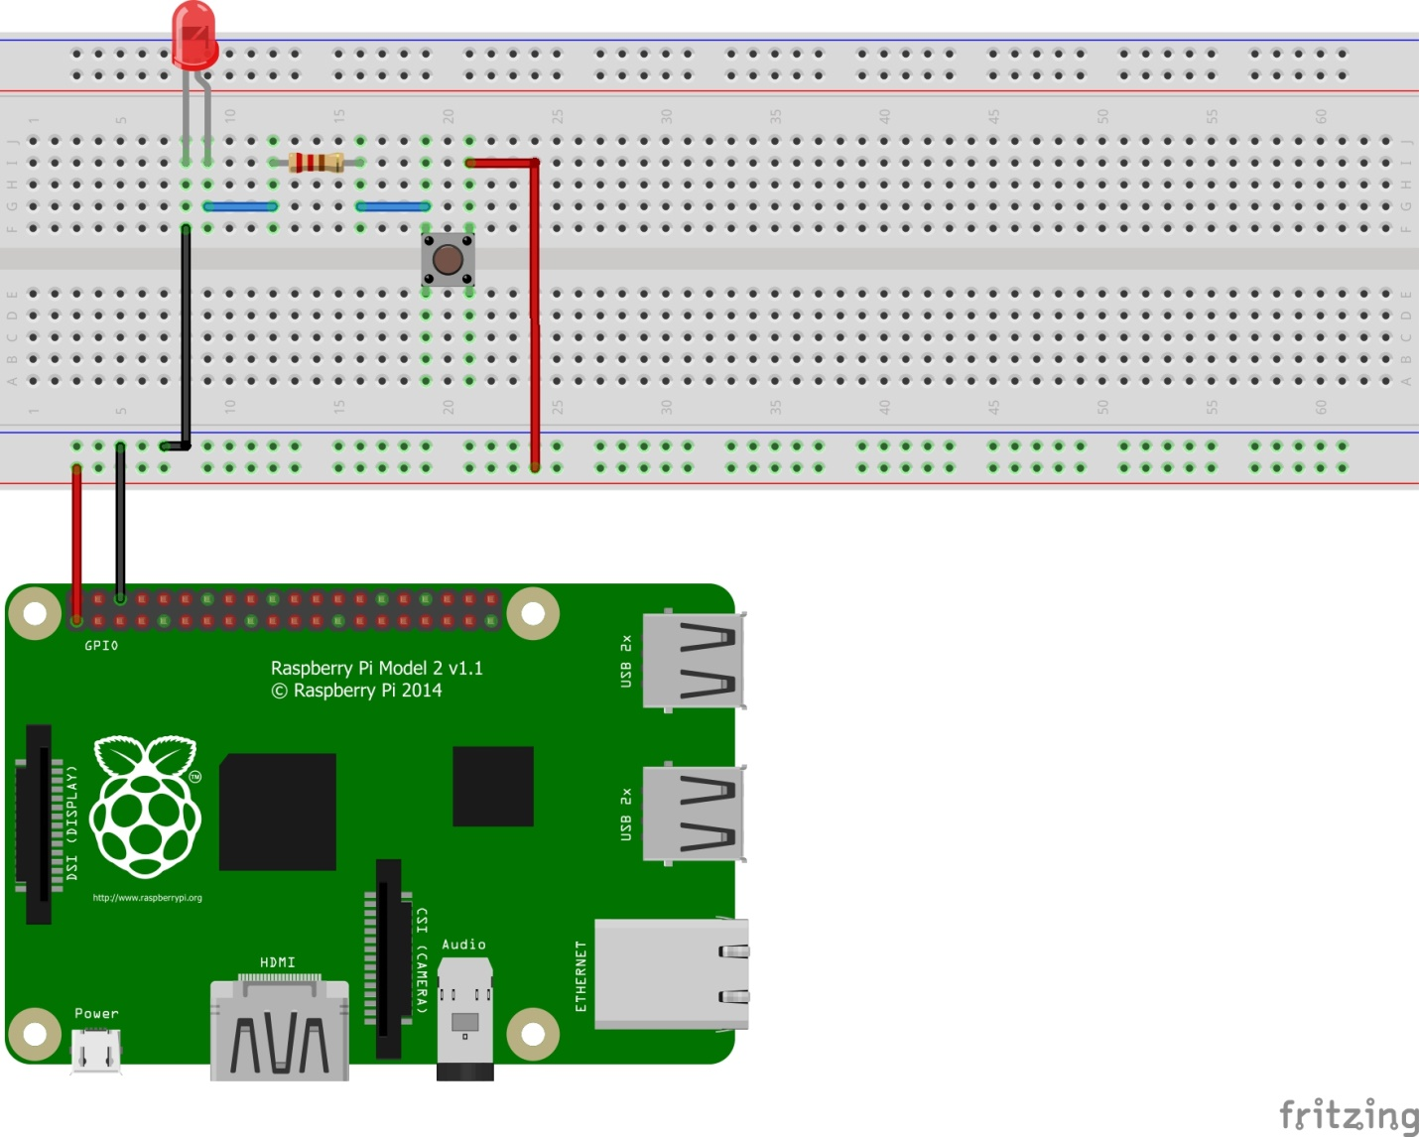
Did your circuit looks like this?
Pin 1 – 3.3V
Pin 6 - GND

Slide 82
Modifying the circuit
Now we are going to change the function of the button.
We are going to program the button such that it will alternate ON/OFF each time it is pressed.

Slide 83
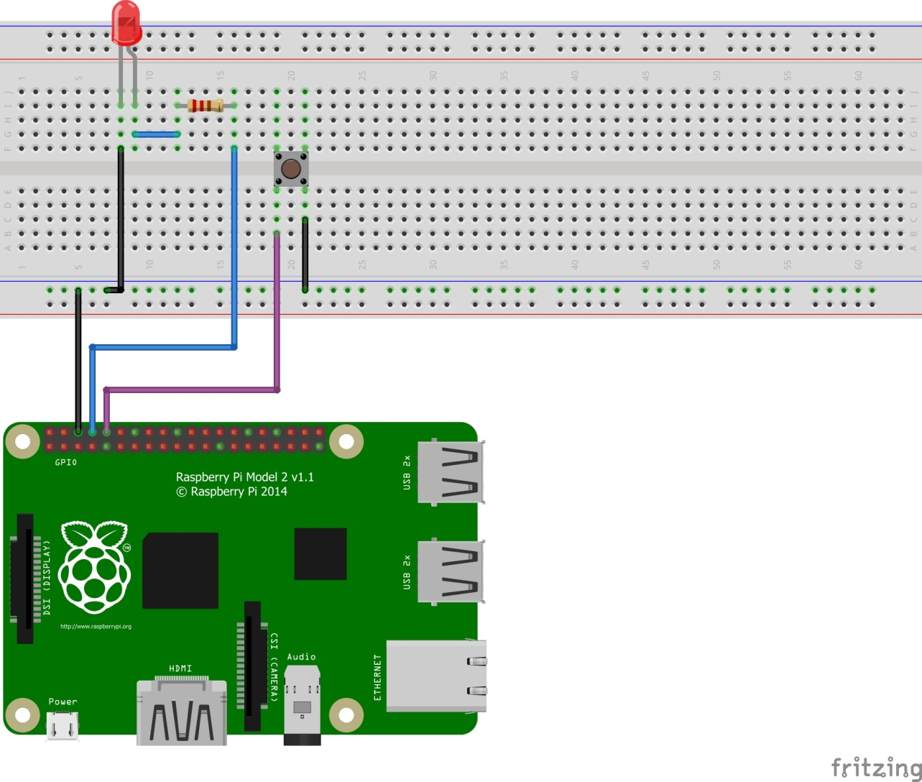
Setup your circuit like this

Slide 84
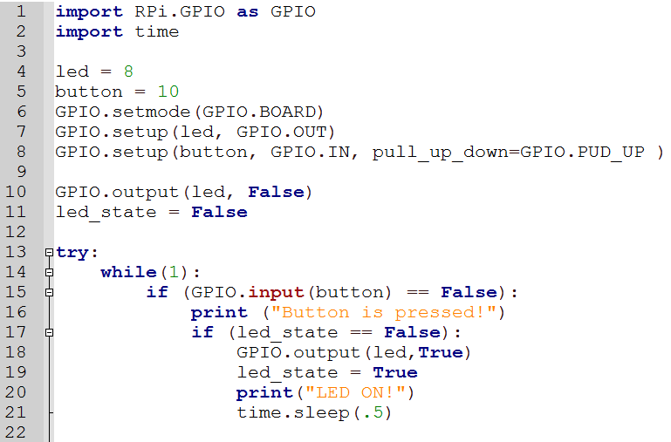
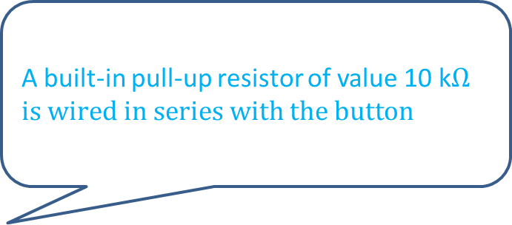
Let’s program it! 1
A built-in pull-up resistor of value 10 k$Ωis wired in series with the button$

Slide 85
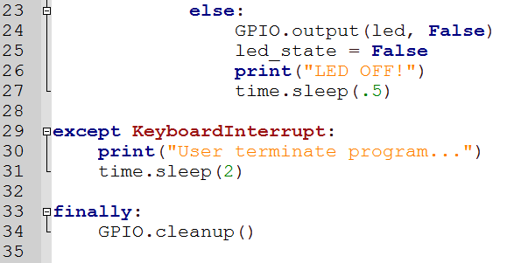
Let’s program it! 2
What do you think is the function of time.sleep() in this program?

Slide 86
RPi Challenge 4
Program the button such that each time it is pressed, the LED will light up for 5 seconds.

Slide 87
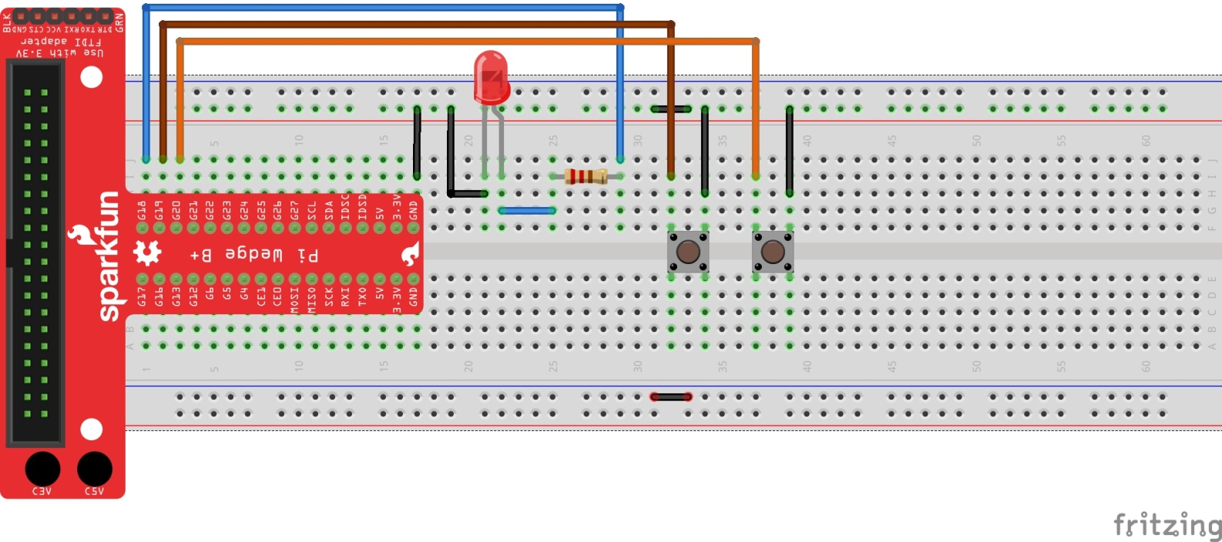
Programming 2 buttons ON/OFF LED
Setup the circuit below

Slide 88
RPi Challenge 5
A) Program such that the left button will ON the LED and the right button will OFF the LED.
B) Program such that the LED will only light up when both buttons are pressed simultaneously.

Slide 89
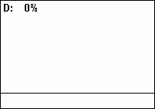
Pulse Width Modulation (PWM)
So far we have programmed the LED to be one of 2 states, ON or OFF.
With PWM, we can set the brightness of the LED. ie set brightness to 20%, 50%, etc… by controlling the duty cycle.
Duty cycle of 0% - OFF
Duty cycle of 100% - ON

Slide 90
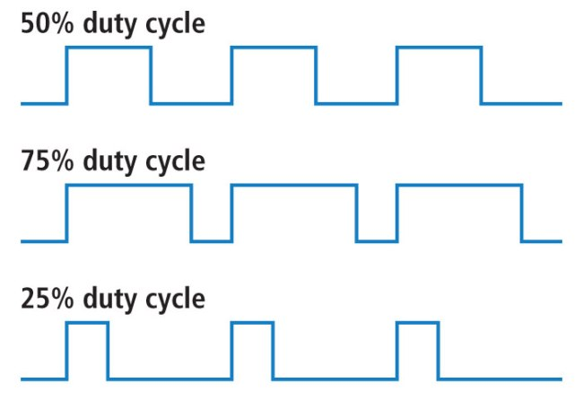
Duty Cycle
We will set the left button to decrease the duty cycle and the right button to increase the duty cycle. With that we can control the brightness of the LED
We can set our LED to have 5 states.
0, 25, 50, 75 or 100 % brightness

Slide 91
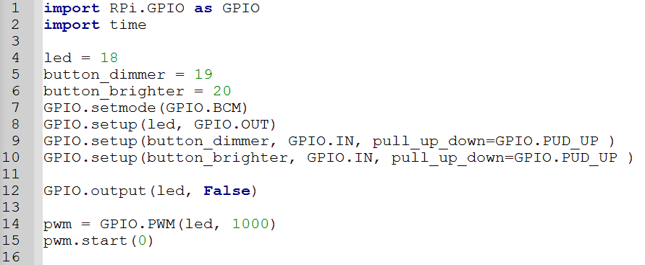
PWM codes 1
sf

Slide 92
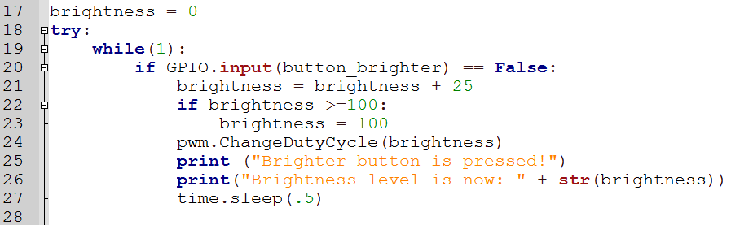
PWM codes 2
The codes given is to increase the brightness of the LED. Can you add in the codes to decrease the brightness?

Slide 93
Assemble GoPiGo
Refer to the pdf file and watch the videos on your laptop on how to assemble the GoPiGo.

Slide 94
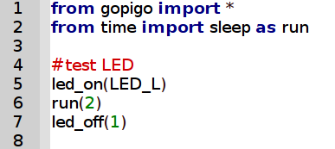
LED control
Try the sample codes to understand how to control the LED
Which LED are we controlling? How do we control the other LED?

Slide 95
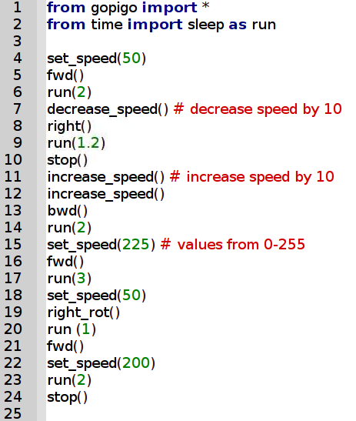
Motor Control
Try the sample codes to understand how to control the motor
Do you know the difference between right() and right_rot()?
How to make a 90º right turn?

Slide 96
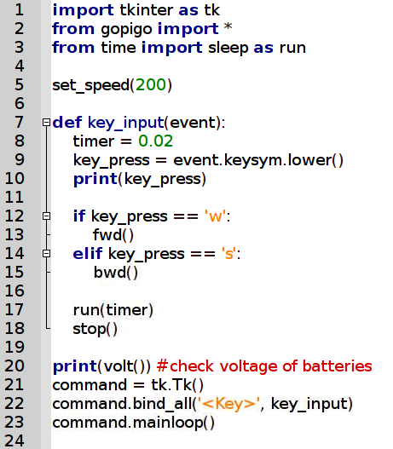
Remote Control
Try the sample codes for remote control
Can you add in the codes for turning?

Slide 97
GoPiGo Missions
Use all the knowledge you have gained today to program GoPiGo to achieve the tasks given to you.

Slide 98
Mission 1
Program GoPiGo to go in a clockwise manner around a rectangular block. It will stop after completing 4 rounds.
The right led will light up when it is turning.

Slide 99
Mission 2
Program GoPiGo to go to a specific destination without hitting any obstacles.
Full led implementation:
Forward (both leds light up)
Right turn (right led light up only)
Left turn (left led light up only)
Backward (both leds blink)
Stop ( both leds off)

